Slide 1
Design of TCP SYN Flood DDoS Attack Detection Using Artificial Immune Systems
By
Gautam Reddy

Slide 2
INTRODUCTION
Information Security has three main important aspects that are confidentiality, integrity, and availability. However, there is much threat that can interfere it.
Distributed Denial of Service (DDoS) is one of the causal factors that can break the availability aspect.
DDoS makes the server unavailable for the user by making a huge traffic until the server cannot handle another connection request.
The artificial immune system is a computational system inspired by human immunology system.

Slide 3
SOLUTION
In the artificial immune system, there are many algorithms based on human immune functions, principles, and models, which are applied to problem-solving.
Dendritic Cell Algorithm is one of an artificial immune system based on danger theory. It proposes the detection of the immune system by the presence of danger signals.
The Danger signal is released by tissues as a result of necrotic cell death (cellular damage caused by pathogenic infection or exposure to extreme condition) within host tissue.
The DCA is also designed to solve the problem in network intrusion detection.

Slide 4
LITERATURE REVIEW
In normal TCP three-way-handshake, the connection starts with the SYN packet sent by the client to the server.
After received the SYN packet, the server reply with SYN/ACK packet to the client.
Last, the client should reply with SYN packet to the server. After all of these process, the connection is established.
One of the shortcomings of TCP connection is the limitation in maintaining half-open connections in TCP.
The half-open connection is the state when the server is waiting for the acknowledgment from the client in three-way handshake.
Because of this shortcoming, the attacker can abuse the limitation to conduct TCP SYN flood attack.

Slide 5
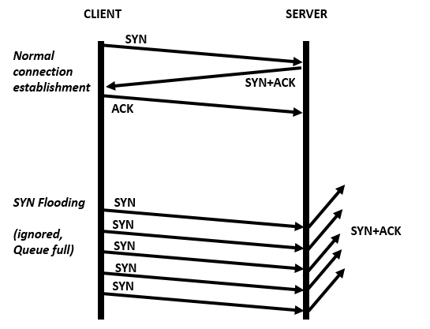
LITERATURE REVIEW
The attacker generates TCP SYN request packets with spoofed source IP. In this situation, the ACK packet never arrives at the server.
Because of it, the server machine with TCP module will be in LISTENING state.

Slide 6
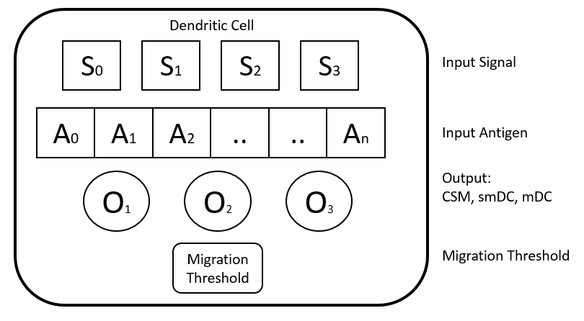
Dendritic Cell Algorithm
Dendritic cell algorithm (DCA) is a kind of artificial immune systems that use danger theory concept.
The DCA is a population-based algorithm that consists many individual dendritic cells as an agent. Each cell can collect and represent data items.

Slide 7
Dendritic Cell Algorithm
The DCA has two types of input data: signal and antigen.
Signal acts as a 'proof' that there is an anomaly on the body. There are four types of signals, i.e. PAMP, danger, safe, and inflammation.
The antigen acts as a ‘suspect’ indicating an activity which is not normal.
Here is the explanation of the type of signal:
a. PAMP: A signal which is a confident indicator of an abnormality
b. Danger signal: Indicator of abnormality but have a lower value of confidence than associated with the PAMP.
c. Safe signal: data which indicates normal system/data behavior.

Slide 8
Input : signals from all categories and antigens;
(SS, PAMP, DS and antigens).
Output : antigen context values; (0/1).
for each DC do /* Preprocessing & Initialization phase */
initialize-DC();
end for
while CSM < mt do /* Detection phase */
get-antigens();
get-signals();
calculate-inter();
update-cumul();
end while
if smDC > mDC then /*Context Assessment phase */
cell-context = 0;
else
cell-context = 1;
end if
for each antigen do /* Classification phase */
if cell-context == 1 then
Nb-mature ++;
end if
end
for each antigen do
MCAV = Nb-mature / Nb-antigen ;
end

